Slide 1
Phonepe Pulse Data Visualization
Task
To visualized the information in a user-friendly manner.
Tools
Microsoft Excel
Microsoft Power BI – For Visualization

Slide 2
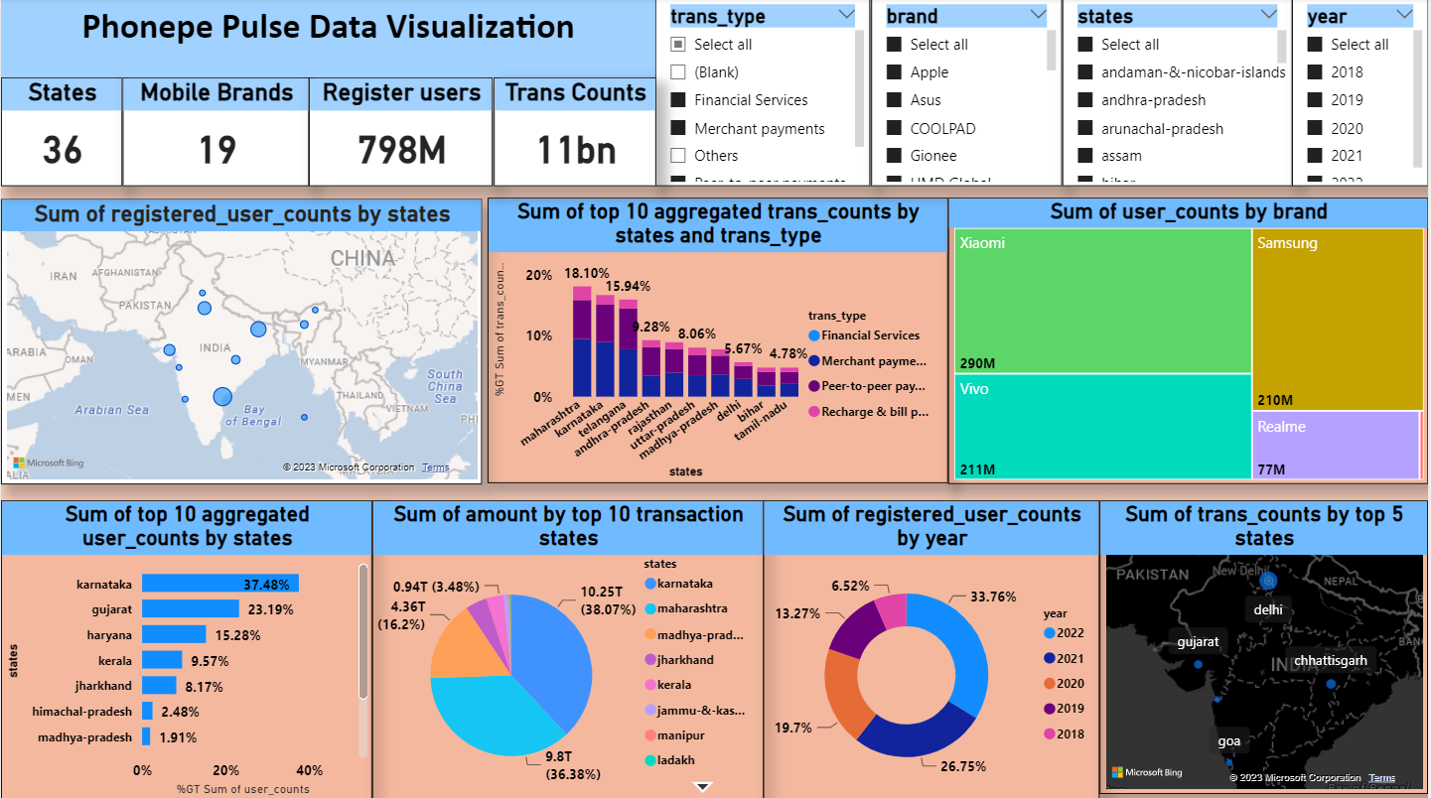
Phonepe Pulse Data Visualization
Summary:
Analysed the data of phonepe pulse and found the varies measures of register users and transactions counts by states. And also found the top mobile brands of phonepe users.

Slide 3
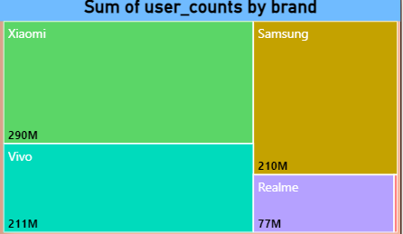
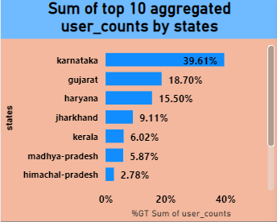
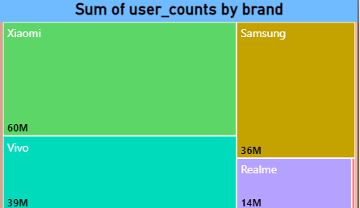
Observations 1
As per the analysis of the given data Xiaomi ,Samsung, Vivo, Realme, and tecno are the top 5 mobile brand users of Phonepe in which Xiaomi stands with 290M users on top.
Observations 2
As per the observation of states, Karnataka has the 38.36% of user counts in the year 2020 where the mobile brand still Xiaomi stands on the top with 60M of users.

Slide 4
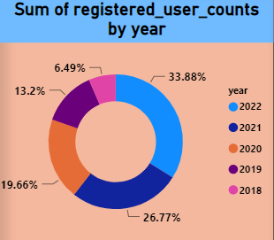
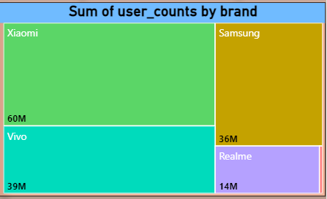
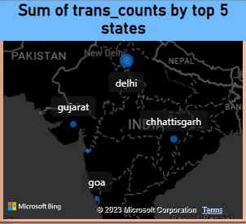
Observations 3
As per the year observation Year 2022 has high number of user counts with the percentage of 33.88% having 60M user counts with the brand Xiaomi.
Observations 4
As per the analysis these are the top five states (Delhi, Gujarat, Chatisgarh, dadra-&-nagar-haveli-&-daman-&-diu, Goa) where the transaction counts are high.

Slide 5
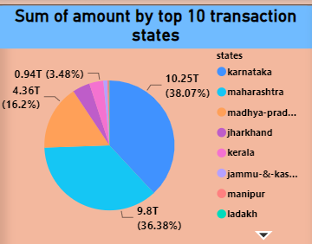
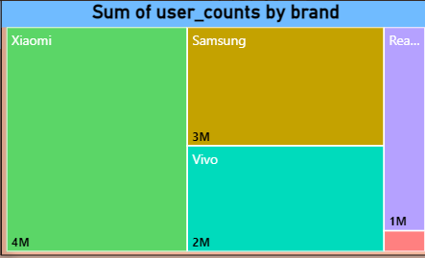
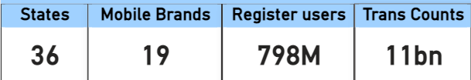
Observations 5
As per the analysis the state Karnataka has the highest transaction with 10.25M and also here the same mobile brand Xiaomi hits the top user counts with 4M.
Observations 6
As per the data we have 36 states with mobile brand user of 19 and the Phonepe registered users are 798M with 11BN transaction counts.
Thank you

